Slide 1


Identifying the Development Impacts of Migration
David McKenzie

Slide 2
LECTURE 3
Using Matching, DD, and RD

Slide 3
Propensity Score Matching

Slide 4
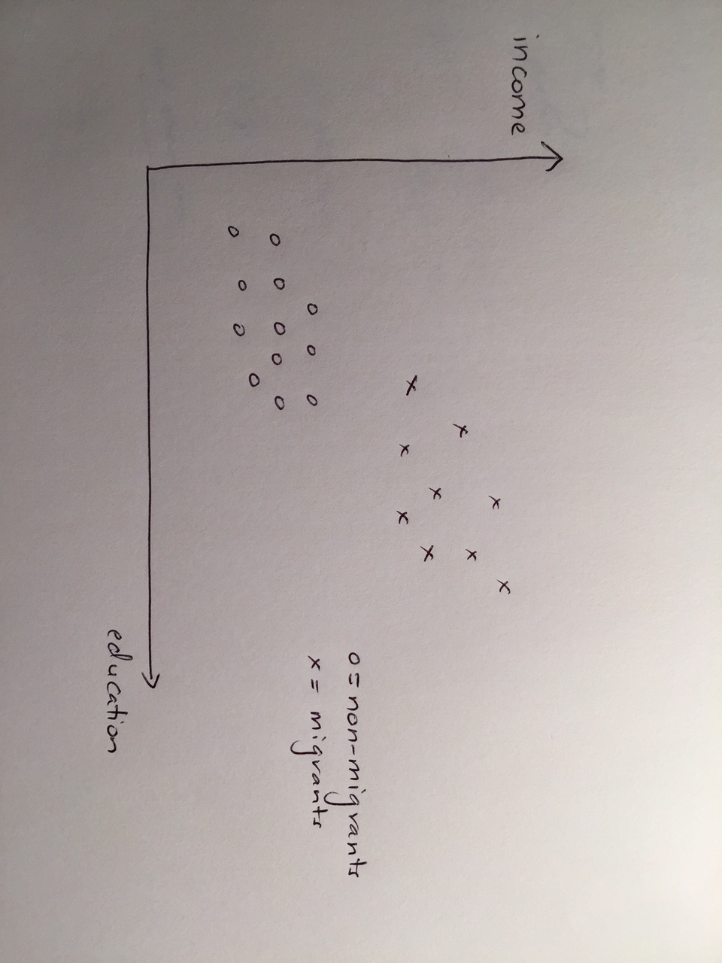
What is the problem we are trying to fix?

Slide 5
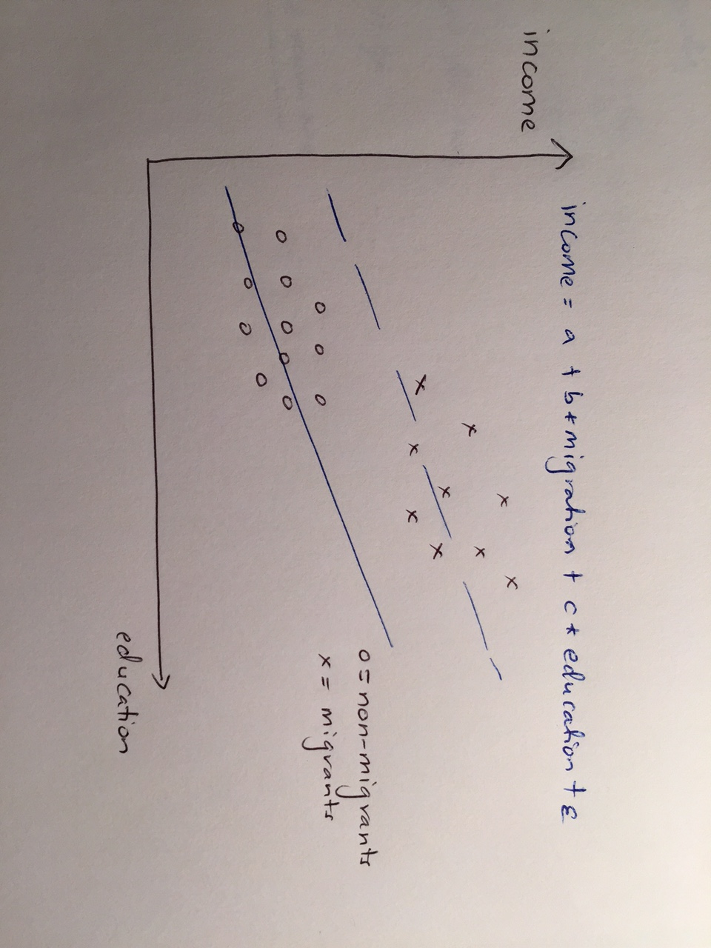
Notes:
OLS will assume linear relationship, extrapolate out to get counterfactuals

Slide 6
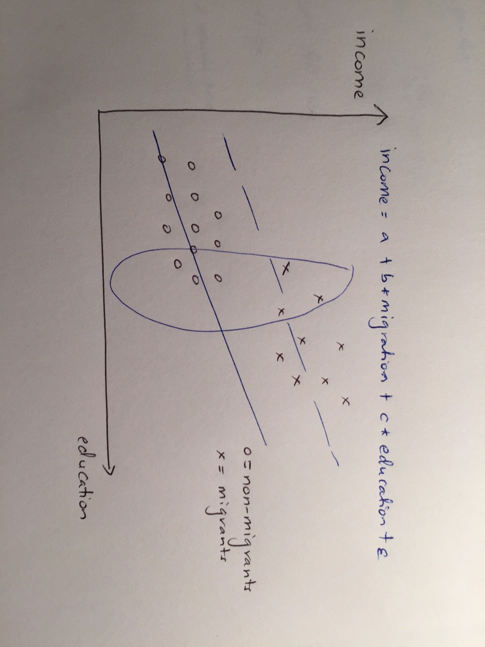
Notes:
But here very little overlap- having to extrapolate a lot

Slide 7
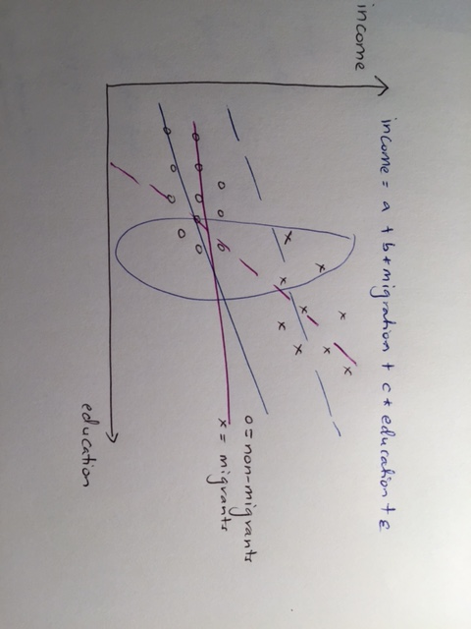
Notes:
It could be that actual relationship like purple lines (a la Borjas) – e.g. US and Europe – return to education higher in US, so see skilled individuals migrate and have big gains from migration, and unskilled not migrate – if they did they would be worse off in the US – so assuming linear relationship to get counterfactual misleading here.

Slide 8
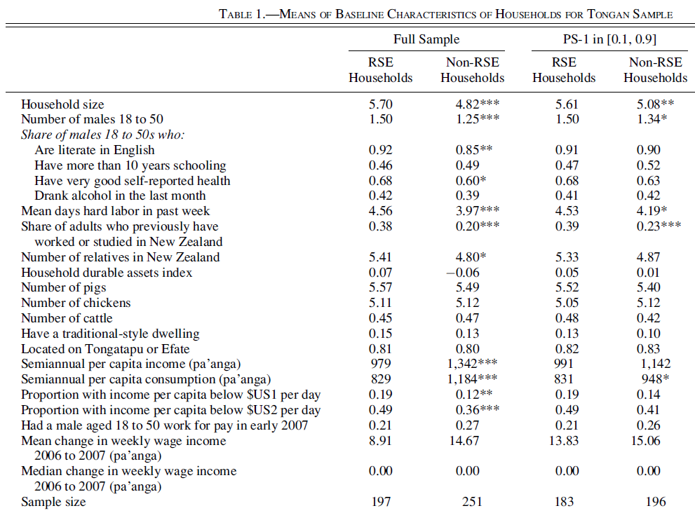
Propensity score Matching

Slide 9
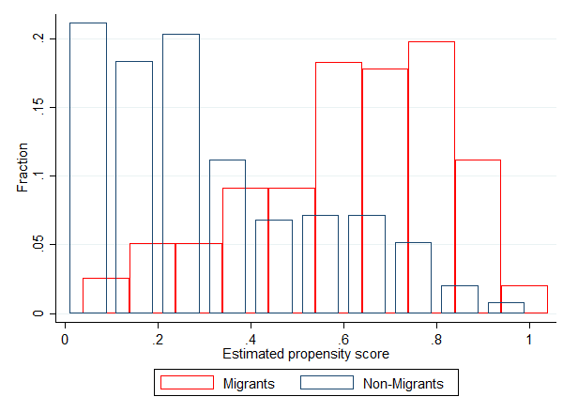

Slide 10
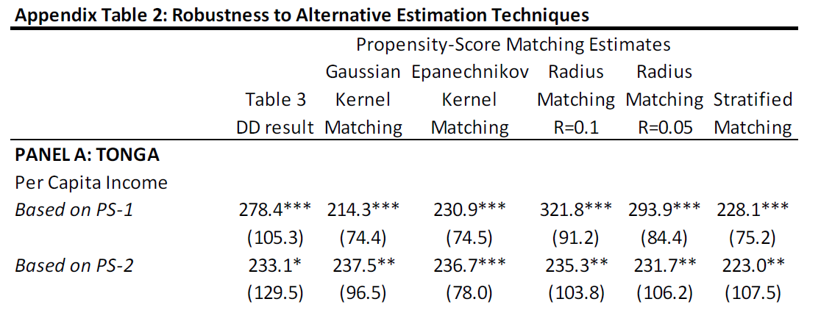

Slide 11
Limitations of PSM
1) Assumption is that Selection is entirely on observables
- but we have many theories that says it depends on lots of things we find it difficult to typically observe
- Borjas – selection on ε – people who expect to earn more, more likely to migrate
- McKenzie/Rapoport – selection on networks and liquidity constraints
- NELM – selection on risk preferences – migration risky activity, but also insurance motive to migrate – should see more risk-seeking individuals from more risk-adverse households move
- migration as venture activity/entrepreneurship - risk-seeking, entrepreneurial individuals more likely to migrate
May be difficult for our surveys to measure all this stuff.

Slide 12
Limitations of PSM
2) many individuals from a standard labor force/household survey may not be good matches at all for migrants
- McKenzie et al. (2010) – using Tonga Labor Force survey – trimming observations with propensity score >0.95 or <0.05 reduces sample of 4,043 to 354 observations.
3) Treatment effect estimated is ATT for those within common support – can’t say anything about treatment effect outside this range.

Slide 13
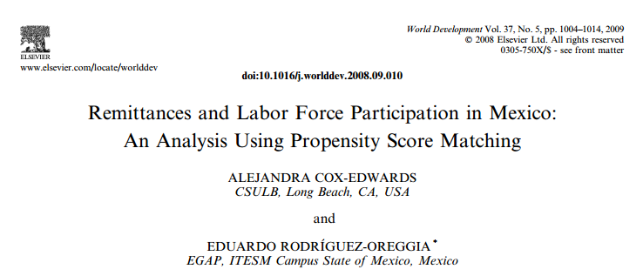

Slide 14
Paper details
Question of interest: impact of persistent remittances on labor force participation of household members remaining in Mexico
Data: 2002 national employment survey (196,000 people aged 12-65).
Match at individual level on:
Location (state household lives in, and rural/urban).
Highest level of schooling in household
Number of members aged 12+
Number of kids <6 in household
Sex, age, age-squared, and schooling
Do these seem like good controls?
Is selection based on these observables plausible? [no discussion of this in paper]

Slide 15
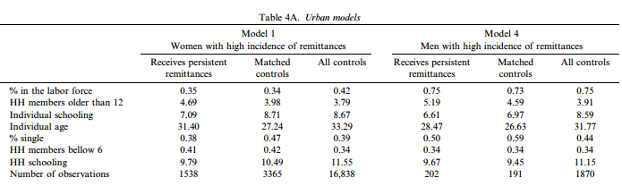

Slide 16
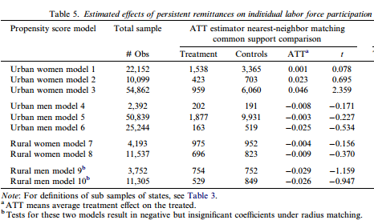

Slide 17
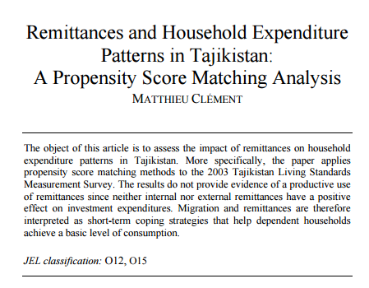

Slide 18
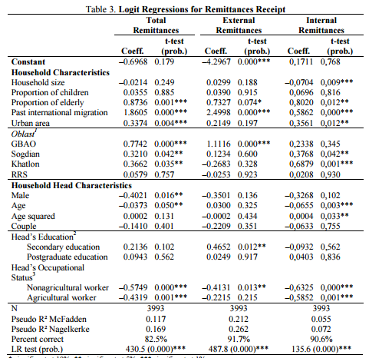

Slide 19
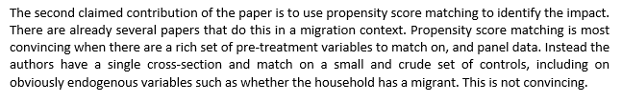
What do referees say?

Slide 20
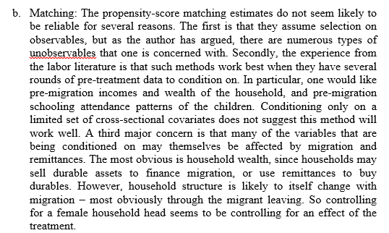

Slide 21
Conditions for PSM to work better
- Surveys of migrant and non-migrant households fielded at same time using same survey instrument in same villages/communities
- Can match on multiple rounds of pre-migration earnings, and on important pre-migration variables like household wealth
- know how migration takes place – e.g. in RSE case what employers looked for (English skills, physical health)
- Have a plausible reason why some households ended up migrating and other observationally similar did not – there was excess demand for RSE migration, so not all who wanted to could migrate
- Don’t match on things that themselves could be affected by migration – so can’t match on who the household head is, on current household income, on current occupations etc -> basically hard to match on any post-migration variables.

Slide 22
Can you still publish PSM studies of migration?
Papers published in 2016-19 in:
Journal of Developing Areas
International journal of social economics
Economic Modelling
Economics Bulletin
Migration letters
Oxford Economic Papers
China Economic Review
Journal of Population Economics

Slide 23
Difference-in-Differences

Slide 24
Difference-in-differences idea
Impact = (Outcome after migration for migrants – Outcome before migration for migrants) – (Outcome after migration for non-migrants – Outcome before migration for non-migrants)
Income = a + b*RSE hh + c*POST + d*RSEhh*POST + e
Parallel trend assumption: assumes in the absence of migration, the migrant and non-migrant households would follow parallel trends in the outcome
Want to see that this was at least the case before migration – check using pre-migration data – need multiple periods of data before migration
Is more plausible when groups are more similar to begin with – so combining matching with DD makes this more plausible.
Controls for baseline differences in MEANS for the two groups.

Slide 25
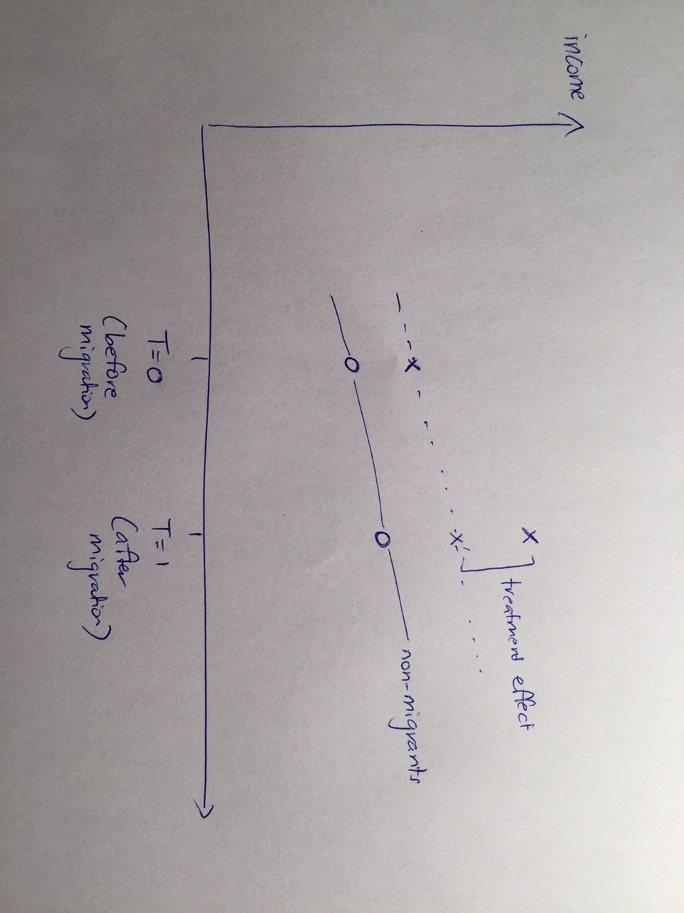

Slide 26
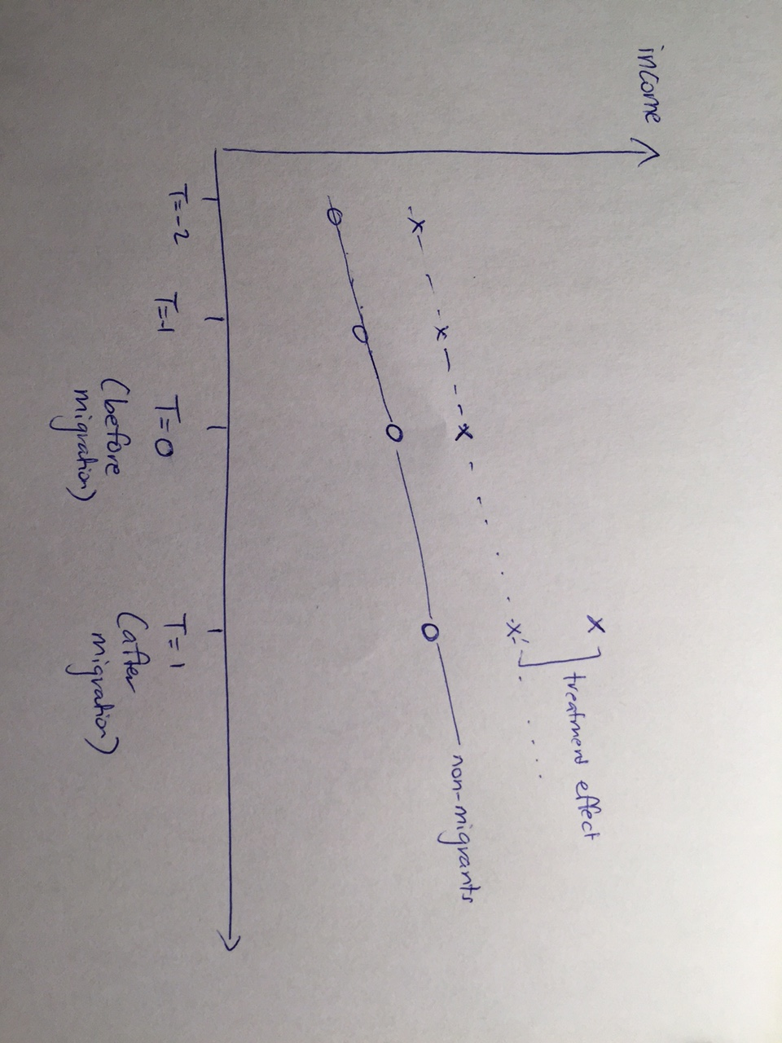

Slide 27

Example
Surveyed 10-16 year olds, and used school records to get test scores in 1st grade and 5th grade, and then retrospective migration histories of their households to know whether they migrated between 2002 and 2006.
Difference-in-Differences then compares change in test scores 2002 to 2006 for households which newly sent a migrant to those which never sent a migrant

Slide 28
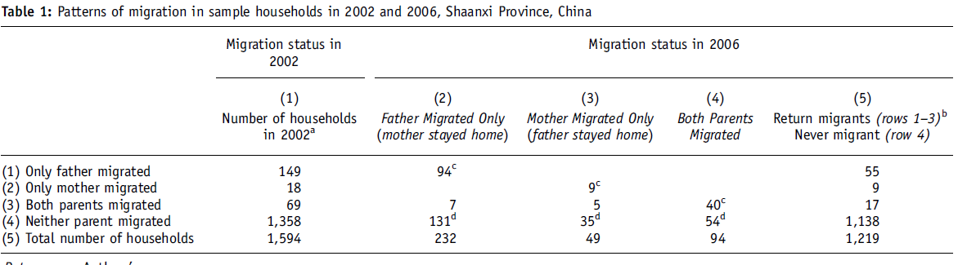
Need big samples to get enough new migrants
Notes:
Note – need to be in place where enough new migration taking place – here internal migration in China, and 4 year period – and still only 16% of sample change migrant status.

Slide 29
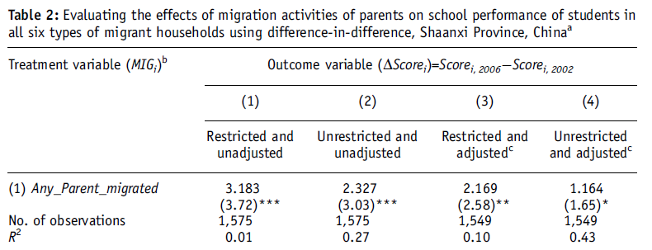
Results
Notes:
Interpretation: kids who had parent migrate actually do better at school – in contrast to view they are harmed by it.

Slide 30
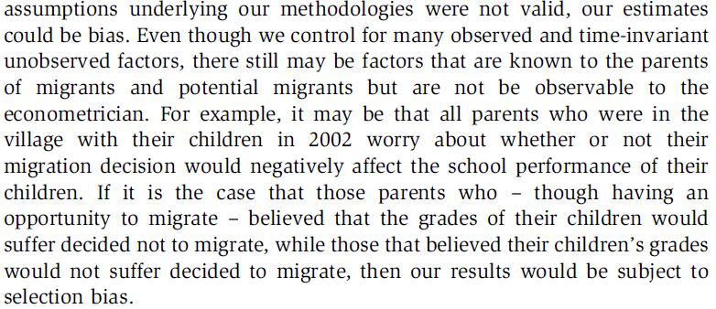
Notes:
Selection on gains argument – here is about treatment heterogeneity- but also question of whether parallel trend in absence of migration?

Slide 31
Example 2: McKenzie et al. (2014)
- Reform in minimum wages the Philippines sets for overseas workers
- Raised minimum domestic helpers can be paid to US$400 a month from $200/month
- Many destinations (e.g. Canada, Italy) already paid above this, so no effect there
- Didn’t affect other occupations
=> DD1: compare changes for maids going to Saudi Arabia, Malaysia, etc to those going to destinations with higher wages
=> DD2: compare changes for maids going to low-wage countries to changes in workers in other industries going to those countries

Slide 32
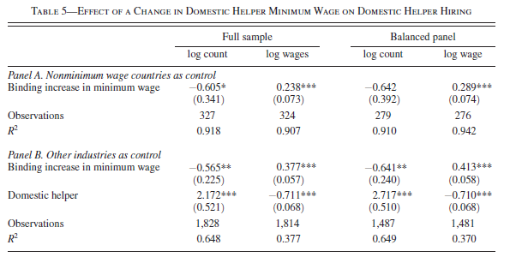
Notes:
Discuss: use of two comparison groups makes more credible.

Slide 33
General DD issues
Identification comes from households which change their migration status
Issues:
1) Why did they change their status?
2) Migration is rare event – do you get enough changing status in most panels?
3) How plausible is common trend assumption if groups very different to start with?

Slide 34
DD + matching
Idea:
- use matching to get observations that are more similar to one another on LEVELS at baseline/pre-migration
- then apply DD to this matched sample (or calculate DD matching estimator)
- implicit assumption is that if closer on LEVELS, then more likely to follow parallel TRENDS/have the same changes in the absence of migration.
- when might this not be a good assumption?

Slide 35
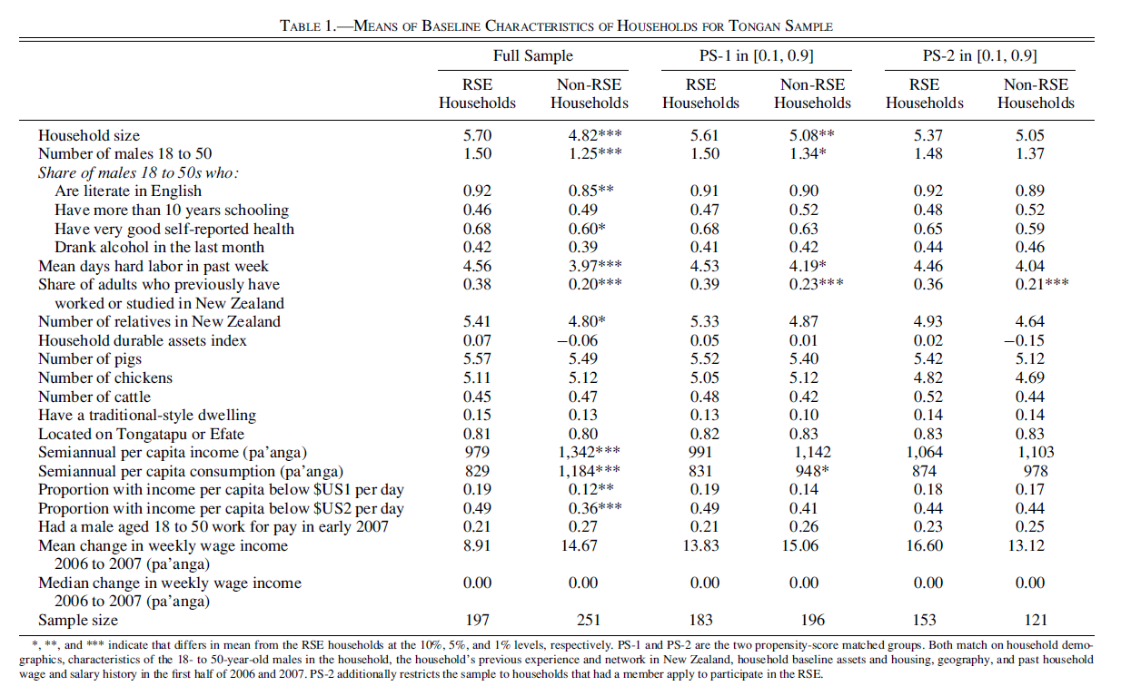
Example of DD + matching – Gibson and McKenzie (ReStat, 2014)
Notes:
Note: matching doesn’t reduce sample much here – because sampling strategy did a lot of the work. But stll see matching makes migrant and non-migrant households more comparable on levels and on trend.

Slide 36
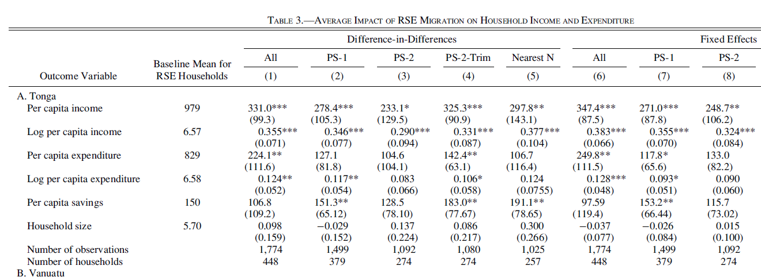
Notes:
Want to see robustness to different matching decisions – here get reasonably similar results regardless of whether use DD or FE, and matching or not.

Slide 37
Regression Discontinuity and Migration

Slide 38
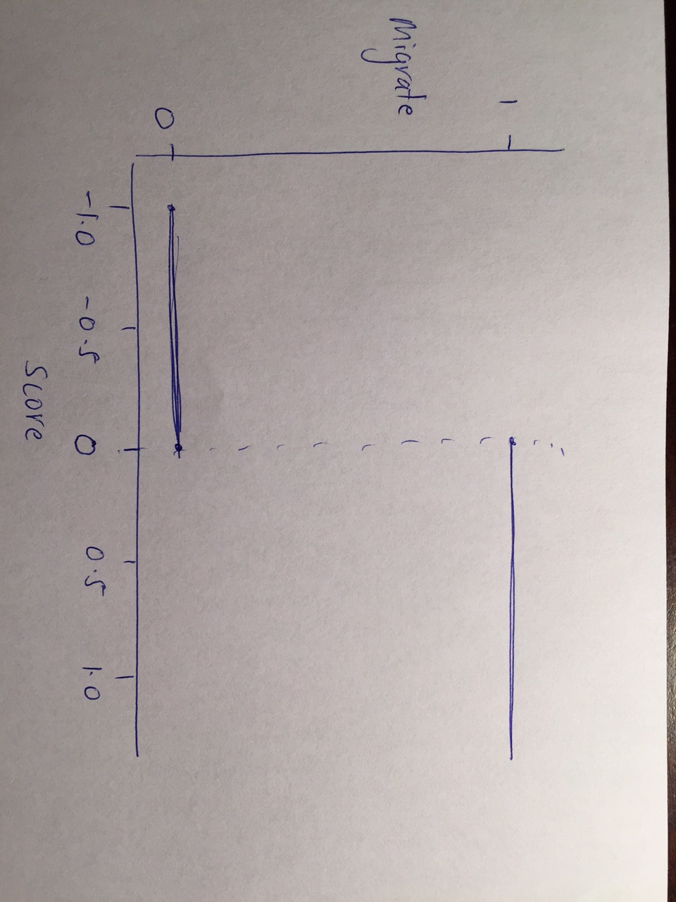
Sharp RD design

Slide 39
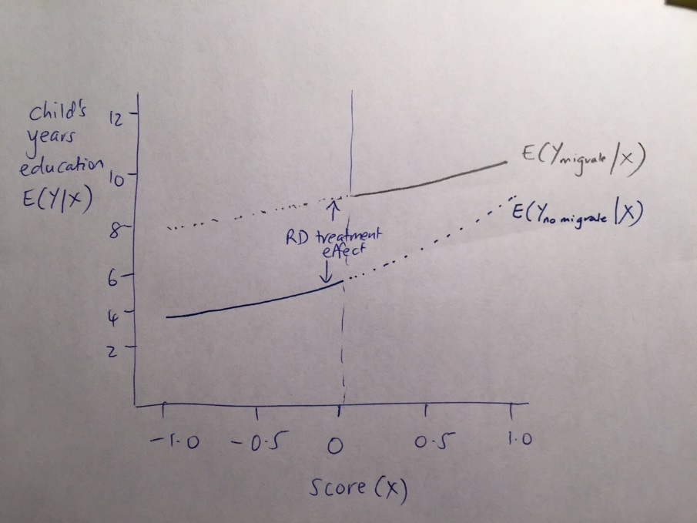
Look for a jump at cutoff

Slide 40
Key assumptions
1) “as random” in local neighborhood of cutoff – can’t choose which side of cutoff you end up on
2) Continuous at cutoff
3) Covariates and density of running variable (score) should be similar near cutoff
Note: treatment effect identified is only local effect

Slide 41
Example: Clemens and Tiongson
- study potential temporary migrants from the Philippines to Korea
- Each applicant was required to achieve a fixed cutoff score on a test of basic Korean language skill. 90 minute, 200 question test
- need score of 120 or higher to secure a work permit
Note: fuzzy RD
- households surveyed 3-5 years after migration
ITT = effect of barely passing the test
LATE or TOT = effect of migration for those who migrate because barely pass test
Survey focuses on those within 5 points on either side of cutoff.
Enumerators attempted to locate the permanent addresses of 2,029 EPS applicants
and obtained 899 completed surveys = > difficulty of tracking after years.

Slide 42
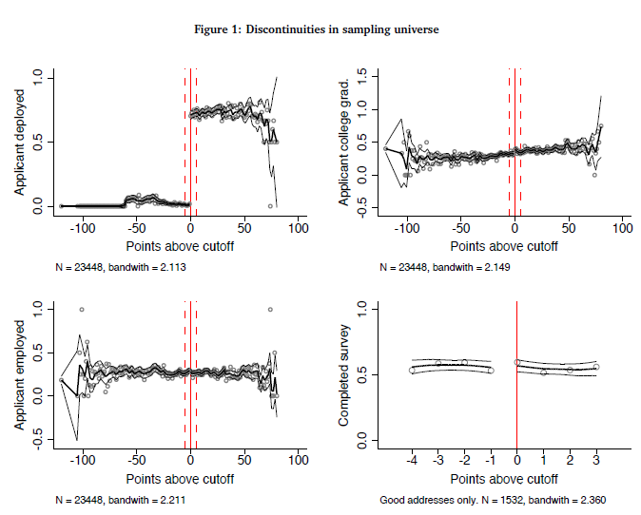

Slide 43
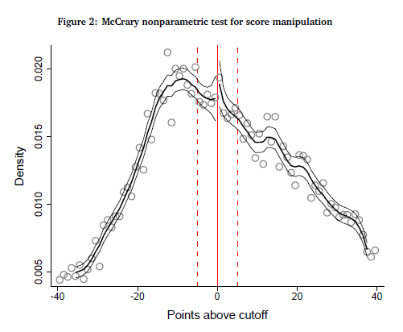
Notes:
Note: concern would be if people decide whether or not to retake the test- so more motivated end up on right – so authors only use score on first attempt at test.

Slide 44
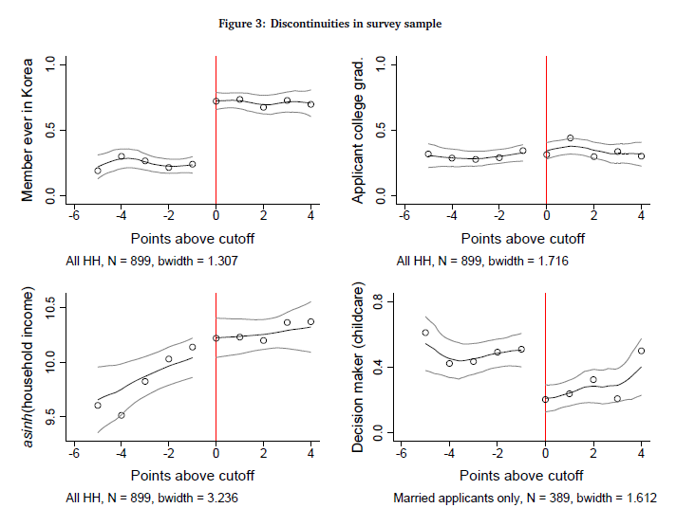

Slide 45
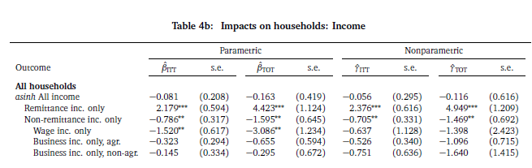
Notes:
No overall impact on income – increase in remittances, which is offset by loss in earnings. Do find some impacts on other outcomes – e.g. kids more likely to be in private schools.

Slide 46

Example 2
In evaluating applicants TalentCorp uses an (education-dependent) experience abroad threshold at which the probability of acceptance to the program increases discontinuously by around 50 percentage points. The actual, precise thresholds used by TalentCorp are not public knowledge

Slide 47
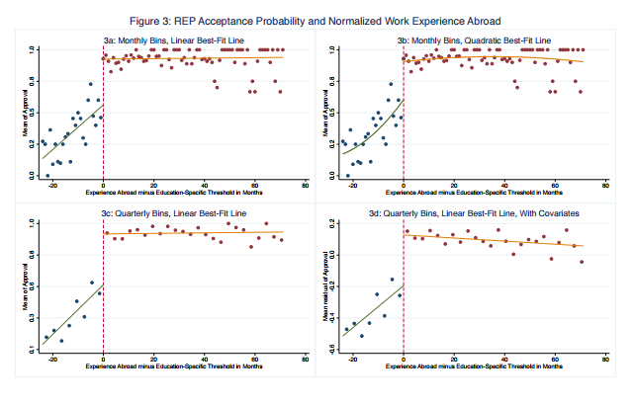

Slide 48
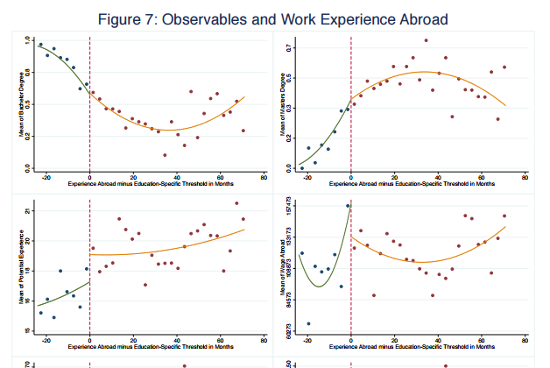

Slide 49
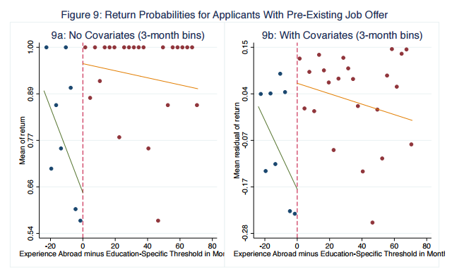

Slide 50

Opportunities for RD?
Points systems
- Australia:
Notes:
Other ideas: programs which process in order applications received until quota reached (e.g. H1B some years); geographic discontinuities (e.g. Finland-Russia paper on forced migration)

Slide 51
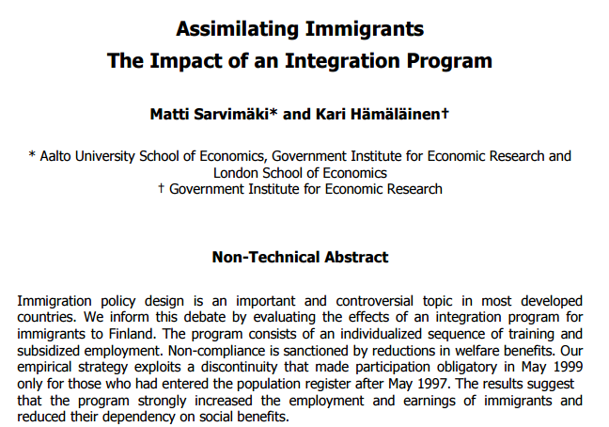

Slide 52
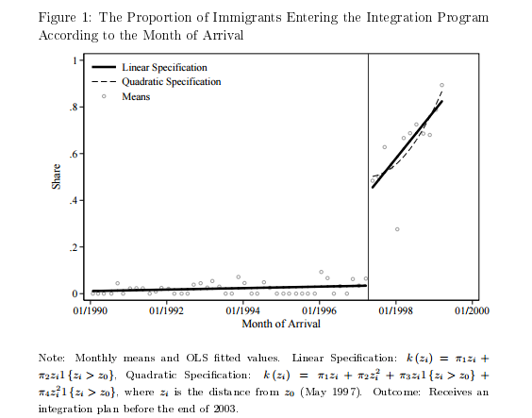

Slide 53
